Slide 1
CS 2200
LAB 9

Slide 2
Brief Overview:
Cache {TLB, Architecture, Replacement Policy, Write Policies, Coherence}

Slide 3
Announcements
Withdrawal deadline was today
Project 3 is due Mar 24th @ 11:59PM (Sunday before spring break ends)
Homework 7 is due Mar 27th @ 6:15PM (Wednesday after spring break)

Slide 4
Translation Lookaside Buffer

Slide 5
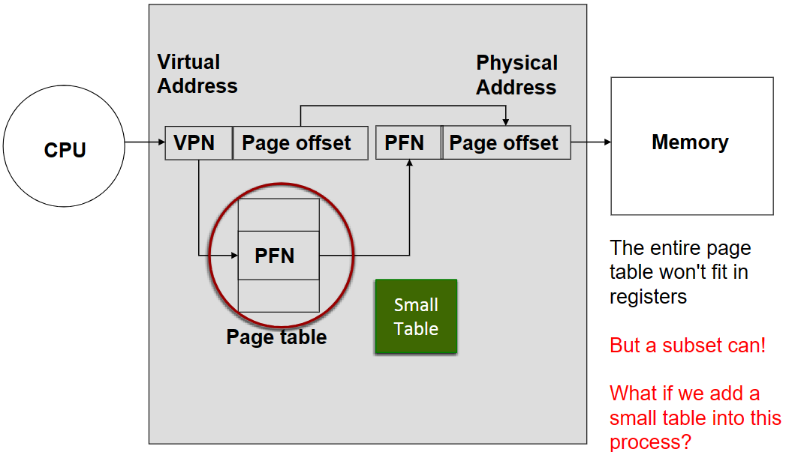
What’s the TLB?
Accessing memory is slow so accessing the page table repeatedly is not efficient
Instead, we use a shortcut -- a small table that holds recently accessed mappings for faster address translation
VPN - PFN mapping
Bits for valid/invalid, user/kernel

Slide 6
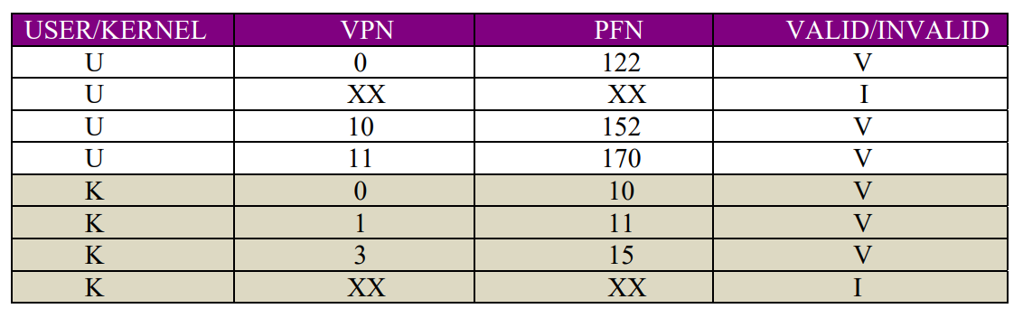
TLB Internals
User entries are specific to each process
Kernel entries are the same for all processes
On context switch, only user entries are invalidated.

Slide 7
Caching

Slide 8
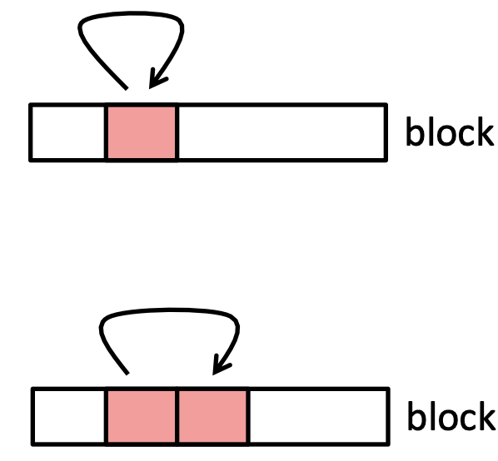
Spatial vs Temporal Locality
Temporal Locality
Tendency of the program to access the same memory location again in the future
If you access memory location i, you’ll likely access i again in the future
Loops
Spatial Locality
Tendency of the program to access adjacent memory locations in the future.
If you access memory location i, you’ll likely access (i+1) and (i+2)...
Instruction fetch, array iteration, etc.

Slide 9
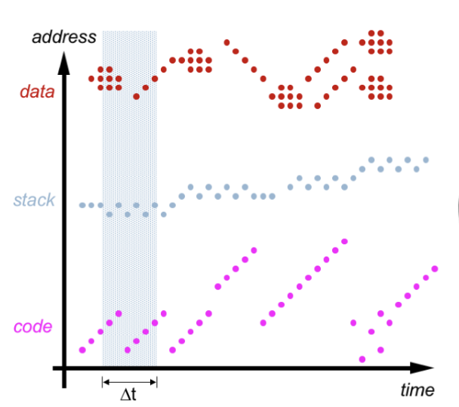
Memory Access Patterns

Slide 10
What’s a Cache?
Unlike our TLB which holds recent VPN-PFN mappings, caches are small instances of memory.
In one case we want to find a location of memory quickly. In the other we are accessing the data we want.
How does it do it?
Map addresses to a table!
If we check our table and our address isn’t stored, we have a cache miss
Otherwise we obtain our data far faster than if we accessed main memory

Slide 11
Hits and Misses
HIT: Target memory address exists in cache (no need for memory lookup)
Hit Ratio(h): Ratio of cache accesses that are hits.
MISS: Target memory address doesn’t exist in cache (need to do a memory lookup)
Miss Ratio(m): Ratio of cache accesses that are misses.
Miss Penalty: Time penalty taken on as result of a cache miss.
3 C’s: Compulsory, Capacity, Conflict

Slide 12
3 C’s of Cache Misses
Compulsory/cold: On the first access to a block, i.e. the block must be brought into the cache.
Capacity: Cache is too small to store all entries that are needed
Conflict: Several blocks are mapped to the same cache address
Misses that would NOT occur with fully-associative cache

Slide 13
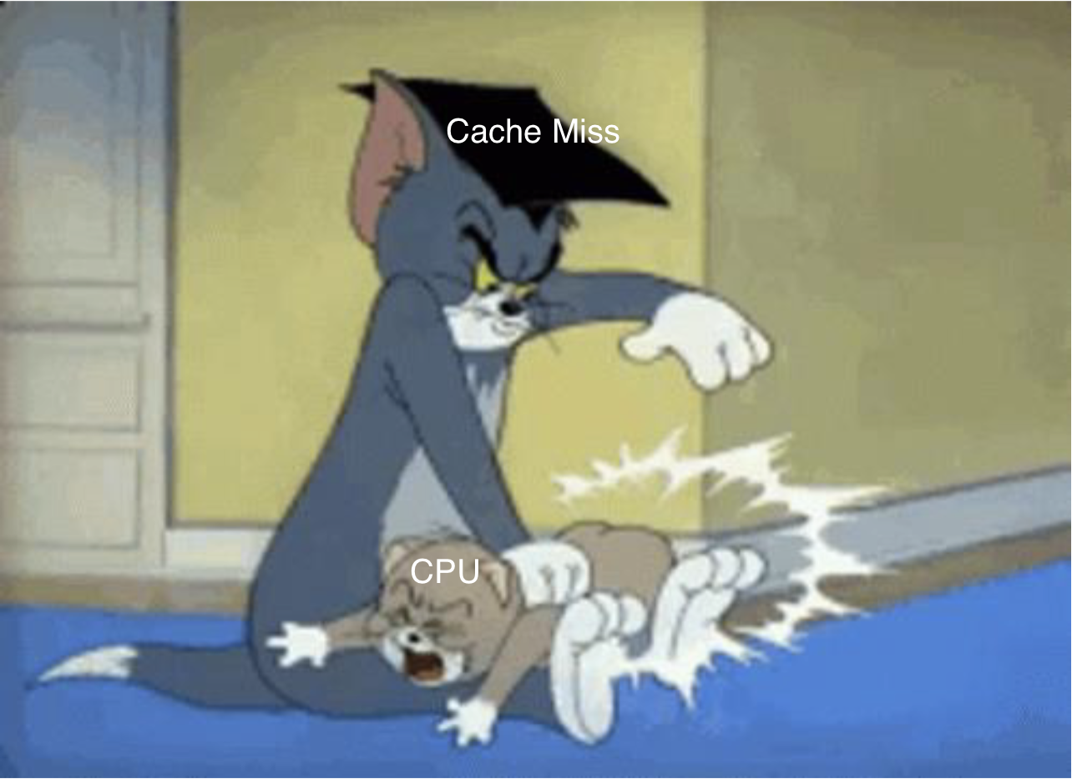
Why Are Cache Misses Bad?

Slide 14
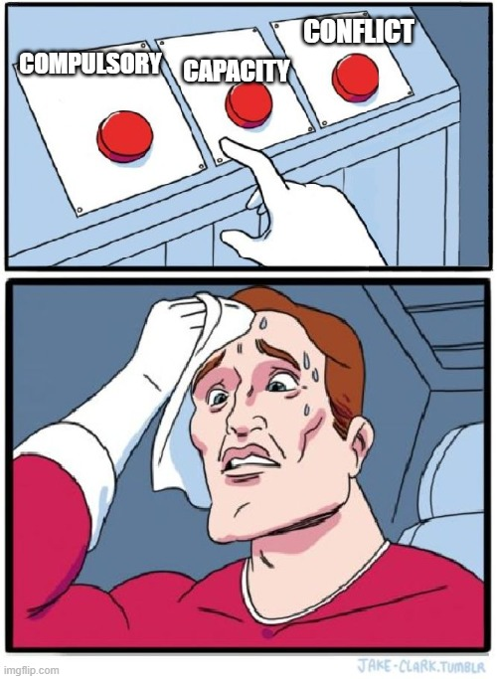
Categorizing Cache Misses
Has the data ever been in the cache before?
NO
YES
Cold/Compulsory
Is the entire cache full?
YES
NO
Capacity
Conflict

Slide 15
Cache Organization

Slide 16
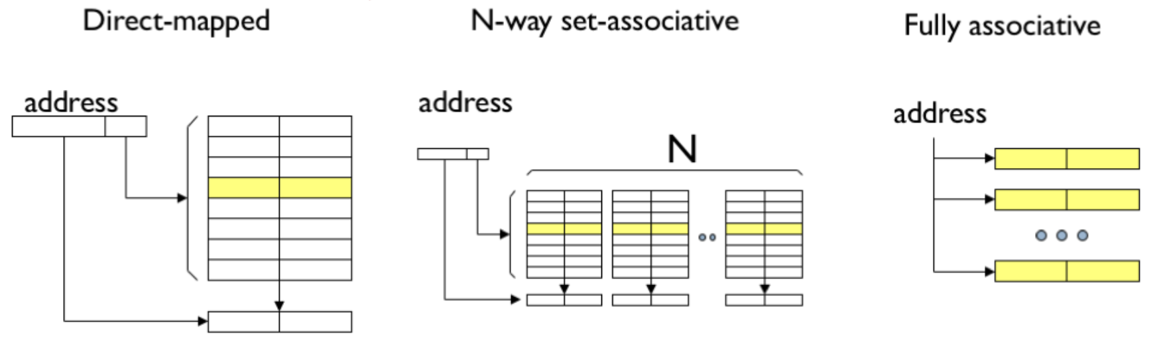
Cache Organization

Slide 17
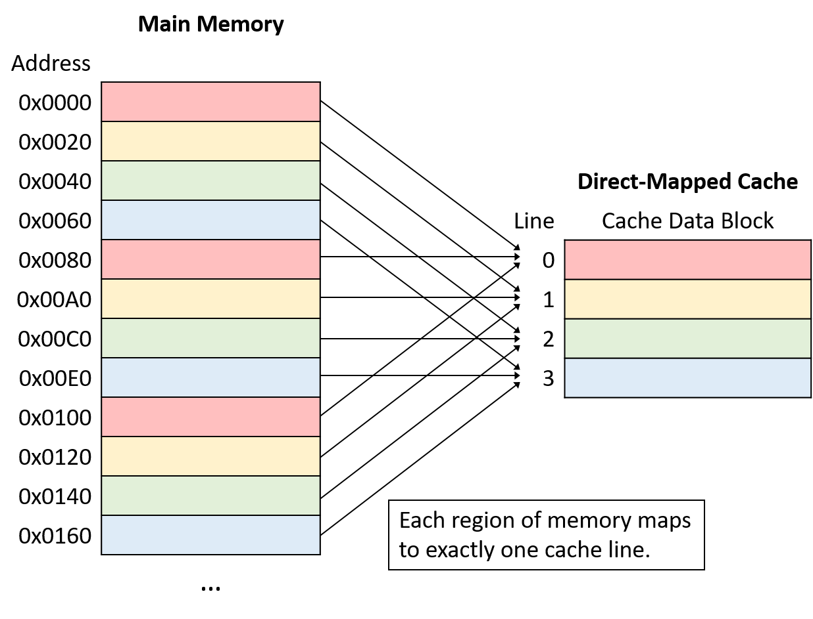
Directly Mapped Cache
Addressing the cache is super efficient.
Can lead to mapping conflicts, so we must store a tag in the cache (not listed in diagram).
Has cache “lines”

Slide 18
Direct Mapped Cache Example
 | Tag | Valid | Data
0 | … | 0 | …
1 | … | 0 | …
2 | … | 0 | …
3 | … | 0 | …
4 | … | 0 | …
5 | … | 0 | …
6 | 0 | 1 | …
7 | … | 0 | …
Mem Access 1
0xA: 0b1010
Tag | Index
1 bit | 3 bits
What Happens?

Slide 19
Direct Mapped Cache Example
 | Tag | Valid | Data
0 | … | 0 | …
1 | … | 0 | …
2 | … | 0 | …
3 | … | 0 | …
4 | … | 0 | …
5 | … | 0 | …
6 | 0 | 1 | …
7 | … | 0 | …
Mem Access 1
0xA: 0b1010
Tag | Index
1 | 010
Cache Miss!
The entry at cache location 10 mod(8) is not valid!

Slide 20
Direct Mapped Cache Example
 | Tag | Valid | Data
0 | … | 0 | …
1 | … | 0 | …
2 | 1 | 1 | …
3 | … | 0 | …
4 | … | 0 | …
5 | … | 0 | …
6 | 0 | 1 | …
7 | … | 0 | …
Mem Access 1
0xA: 0b1010
Tag | Index
1 | 010
Bring in the data to cache location 10 mod(8) and update metadata

Slide 21
Direct Mapped Cache Example
 | Tag | Valid | Data
0 | … | 0 | …
1 | … | 0 | …
2 | 1 | 1 | …
3 | … | 0 | …
4 | … | 0 | …
5 | … | 0 | …
6 | 0 | 1 | …
7 | … | 0 | …
Mem Access 2
0x6: 0b0110
Tag | Index
1 bit | 3 bit
What happens?

Slide 22
Direct Mapped Cache Example
 | Tag | Valid | Data
0 | … | 0 | …
1 | … | 0 | …
2 | 1 | 1 | …
3 | … | 0 | …
4 | … | 0 | …
5 | … | 0 | …
6 | 0 | 1 | …
7 | … | 0 | …
Mem Access 2
0x6: 0b0110
Tag | Index
0 | 110
Cache Hit!
Cache location 6 mod(8) has a matching tag and is valid.

Slide 23
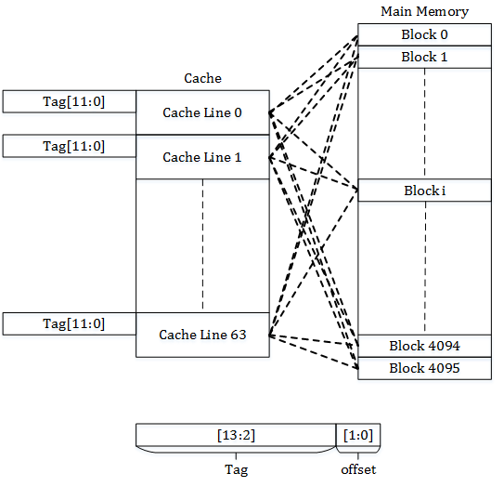
Fully Associative Cache
Allow any recently used data into the cache, no mapping for where it is placed.
Consider it as a n-way set associative cache, with n many cache blocks.
Access time is very slow since the cache lookup hardware is more complex (a comparator for every cache line).

Slide 24
Fully Associative Cache Example
Way 0
Way 1
Way 2
Way 3
Tag | Valid | Data
... | 0 | ...
Tag | Valid | Data
0100 | 1 | ...
Tag | Valid | Data
... | 0 | ...
Tag | Valid | Data
1111 | 1 | ...
Tag | Offset
4 bits | 4 bits
Mem Access 1
0x47: 0b01000111
What happens?

Slide 25
Fully Associative Cache Example
Way 0
Way 1
Way 2
Way 3
Tag | Valid | Data
... | 0 | ...
Tag | Valid | Data
0100 | 1 | ...
Tag | Valid | Data
... | 0 | ...
Tag | Valid | Data
1111 | 1 | ...
Tag | Offset
0100 | 0111
Cache Hit!
Every block is simultaneously queried for a matching tag
Mem Access 1
0x47: 0b01000111

Slide 26
Fully Associative Cache Example
Way 0
Way 1
Way 2
Way 3
Tag | Valid | Data
... | 0 | ...
Tag | Valid | Data
0100 | 1 | ...
Tag | Valid | Data
... | 0 | ...
Tag | Valid | Data
1111 | 1 | ...
Tag | Offset
4 bits | 4 bits
Mem Access 2
0x79: 0b01111001
What happens?

Slide 27
Fully Associative Cache Example
Way 0
Way 1
Way 2
Way 3
Tag | Valid | Data
... | 0 | ...
Tag | Valid | Data
0100 | 1 | ...
Tag | Valid | Data
... | 0 | ...
Tag | Valid | Data
1111 | 1 | ...
Tag | Offset
0111 | 1001
Cache Miss!
No valid block in our cache has a matching tag
Mem Access 2
0x79: 0b01111001

Slide 28
Fully Associative Cache Example
Way 0
Way 1
Way 2
Way 3
Tag | Valid | Data
... | 0 | ...
Tag | Valid | Data
0100 | 1 | ...
Tag | Valid | Data
0111 | 1 | ...
Tag | Valid | Data
1111 | 1 | ...
Find any empty line in the cache to allocate the block and update the metadata
Tag | Offset
0111 | 1001
Mem Access 2
0x79: 0b01111001

Slide 29
Fully Associative Cache Example
Way 0
Way 1
Way 2
Way 3
Tag | Valid | Data
1000 | 1 | ...
Tag | Valid | Data
0100 | 1 | ...
Tag | Valid | Data
0000 | 1 | ...
Tag | Valid | Data
1111 | 1 | ...
Tag | Offset
0111 | 1001
What if there are no empty cache blocks??
Use a replacement policy! (discussed later)
Mem Access 2
0x79: 0b01111001

Slide 30
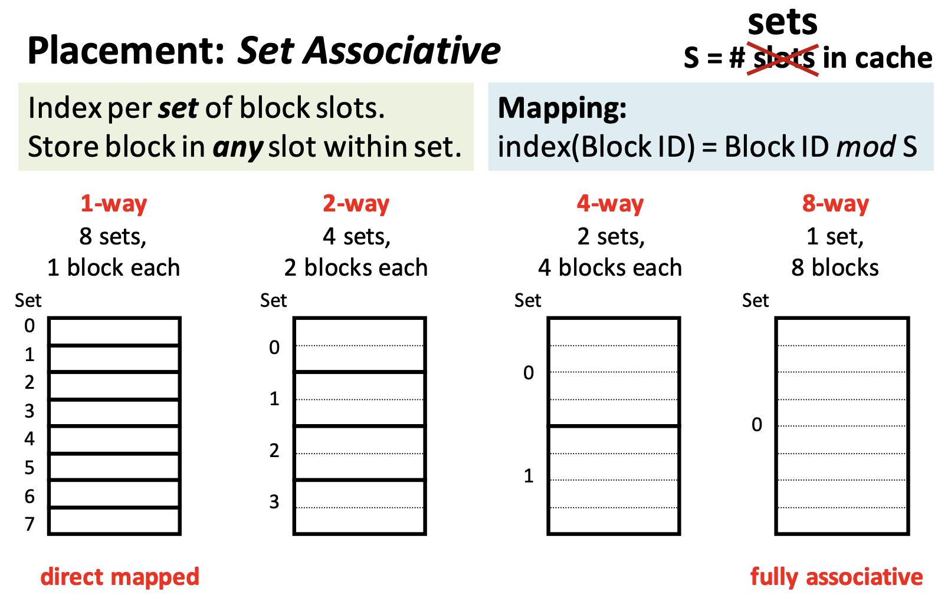
Set Associative Cache
Combines the best of both full associative and direct caches.
Allows for n entries to be directly mapped into a set in the cache for a n-way associative cache.

Slide 31
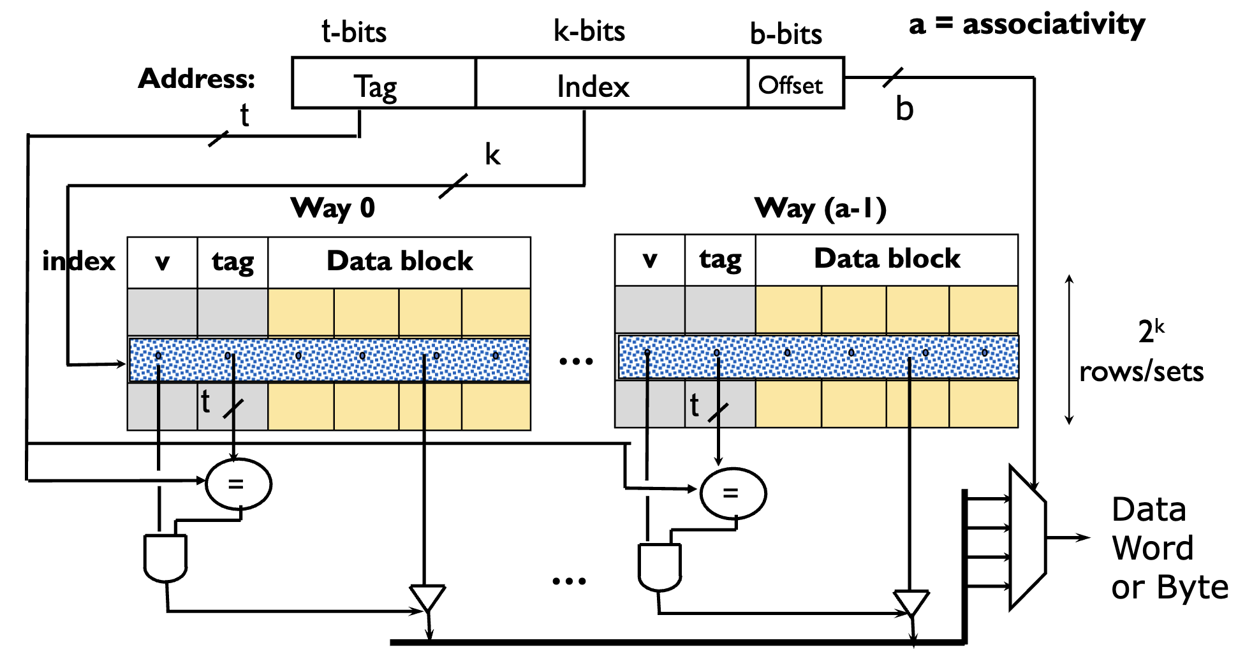
Set Associative Architecture

Slide 32
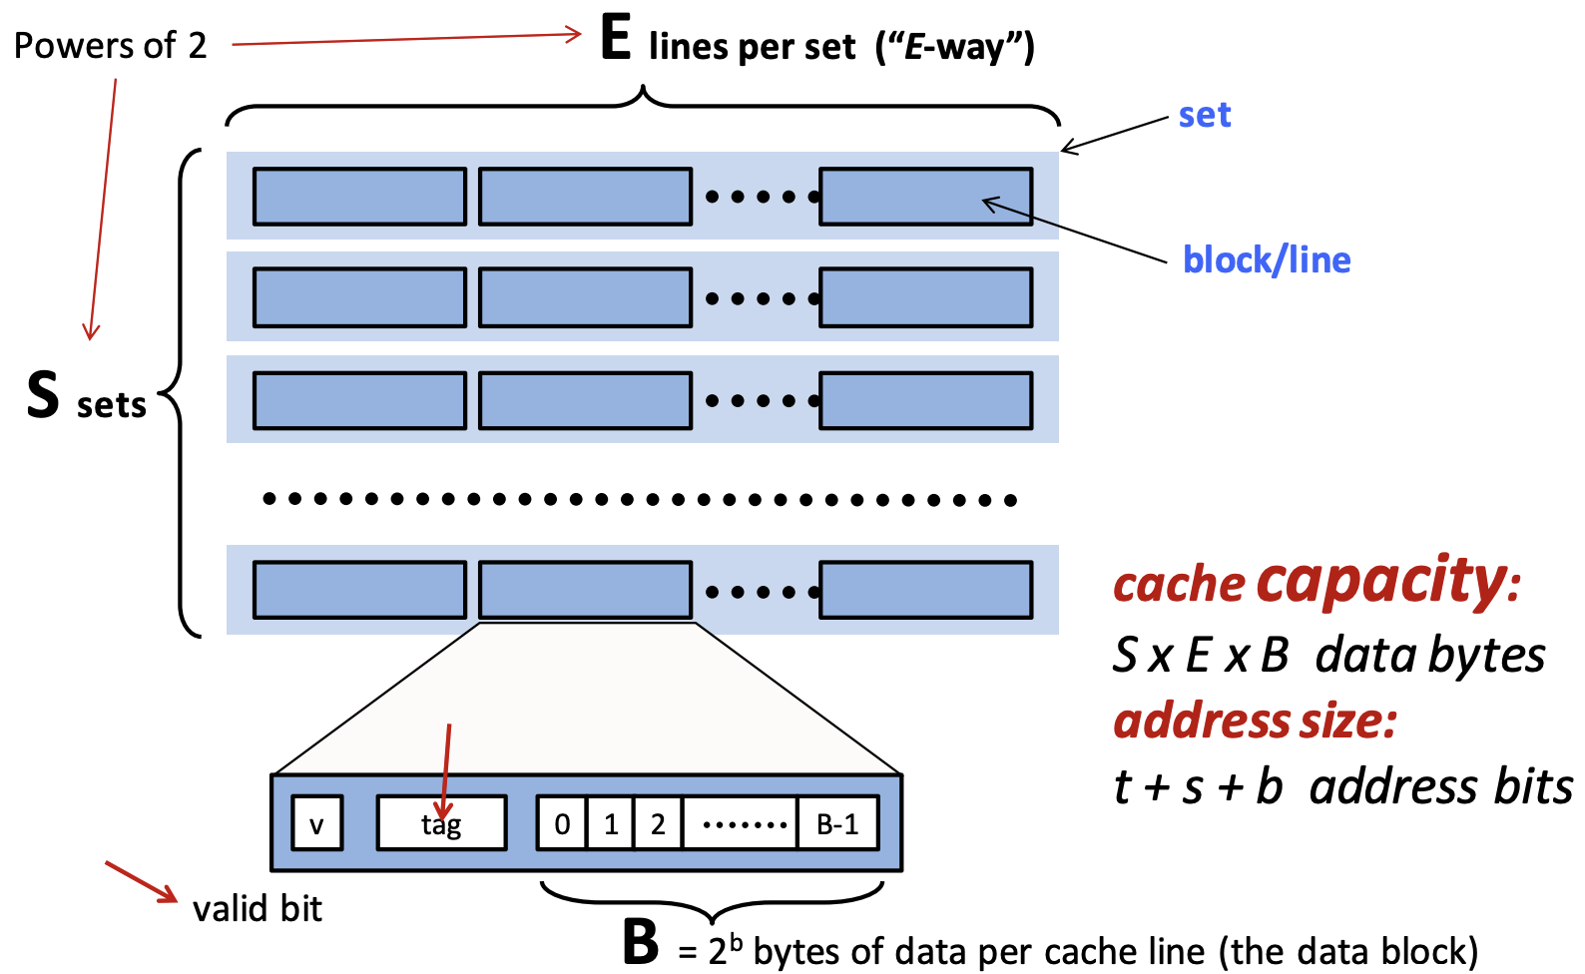
Cache Size and Cache Addresses

Slide 33
Set Associative Cache Address Example
Consider a byte-addressable memory system with 32-bit addresses, and a 8 KByte (1KByte = 1024 bytes) 4-way set associative cache with a block size of 64 bytes.
Calculate offset bits.
t-bits k-bits b-bits
Tag | Index | Offset

Slide 34
Set Associative Cache Address Example
Consider a memory system with 32-bit addresses, and a 8 KByte (1KByte = 1024 bytes) 4-way set associative cache with a block size of 64 bytes.
Calculate offset bits.
b = log2(block size) = log2(64) = 6
Calculate index bits.
t-bits k-bits 6-bits
Tag | Index | Offset

Slide 35
Set Associative Cache Address Example
Consider a memory system with 32-bit addresses, and a 8 KByte (1KByte = 1024 bytes) 4-way set associative cache with a block size of 64 bytes.
Calculate offset bits.
b = log2(block size) = log2(64) = 6
Calculate index bits.
k = log2(cache size/(associativity * block size))
= log2(8192 / (4 * 64)) = 5
Calculate tag bits.
t-bits 5-bits 6-bits
Tag | Index | Offset

Slide 36
Set Associative Cache Address Example
Consider a memory system with 32-bit addresses, and a 8 KByte (1KByte = 1024 bytes) 4-way set associative cache with a block size of 64 bytes.
Calculate offset bits.
b = log2(block size) = log2(64) = 6
Calculate index bits.
k = log2(cache size/(associativity * block size))
= log2(8192 / (4 * 64)) = 5
Calculate tag bits.
t = 32 bit address - k - b = 21
21-bits 5-bits 6-bits
Tag | Index | Offset

Slide 37
2-Way Set Associative Cache Example
Way 0
Way 1
Tag | Valid | Data
... | 0 | ...
... | 0 | ...
... | 0 | ...
... | 0 | ...
Tag | Valid | Data
... | 0 | ...
... | 0 | ...
... | 0 | ...
... | 0 | ...
Set0: 00
Set1: 01
Set2: 02
Set3: 03
Tag | Index | Offset
4 bits | 2 bits | 2 bits

Slide 38
2-Way Set Associative Cache Example
Way 0
Way 1
Tag | Valid | Data
... | 0 | ...
... | 0 | ...
... | 0 | ...
... | 0 | ...
Tag | Valid | Data
... | 0 | ...
... | 0 | ...
... | 0 | ...
... | 0 | ...
Set0: 00
Set1: 01
Set2: 02
Set3: 03
Tag | Index | Offset
4 bits | 2 bits | 2 bits
Mem Access 1
0x72: 0b01110010

Slide 39
2-Way Set Associative Cache Example
Way 0
Way 1
Tag | Valid | Data
... | 0 | ...
... | 0 | ...
... | 0 | ...
... | 0 | ...
Tag | Valid | Data
... | 0 | ...
... | 0 | ...
... | 0 | ...
... | 0 | ...
Set0: 00
Set1: 01
Set2: 02
Set3: 03
Tag | Index | Offset
0111 | 00 | 10
Mem Access 1
0x72: 0b01110010

Slide 40
2-Way Set Associative Cache Example
Way 0
Way 1
Tag | Valid | Data
... | 0 | ...
... | 0 | ...
... | 0 | ...
... | 0 | ...
Tag | Valid | Data
... | 0 | ...
... | 0 | ...
... | 0 | ...
... | 0 | ...
Set0: 00
Set1: 01
Set2: 02
Set3: 03
Tag | Index | Offset
0111 | 00 | 10
Mem Access 1
0x72: 0b01110010
What will happen?

Slide 41
2-Way Set Associative Cache Example
Way 0
Way 1
Tag | Valid | Data
... | 0 | ...
... | 0 | ...
... | 0 | ...
... | 0 | ...
Tag | Valid | Data
... | 0 | ...
... | 0 | ...
... | 0 | ...
... | 0 | ...
Set0: 00
Set1: 01
Set2: 02
Set3: 03
Cache Miss!
No valid blocks in the set
Tag | Index | Offset
0111 | 00 | 10
Mem Access 1
0x72: 0b01110010

Slide 42
2-Way Set Associative Cache Example
Way 0
Way 1
Tag | Valid | Data
0111 | 1 | ...
... | 0 | ...
... | 0 | ...
... | 0 | ...
Tag | Valid | Data
... | 0 | ...
... | 0 | ...
... | 0 | ...
... | 0 | ...
Set0: 00
Set1: 01
Set2: 02
Set3: 03
Cache Miss!
Overwrite an invalid block in our cache if possible
Tag | Index | Offset
0111 | 00 | 10
Mem Access 1
0x72: 0b01110010

Slide 43
2-Way Set Associative Cache Example
Way 0
Way 1
Tag | Valid | Data
0111 | 1 | ...
... | 0 | ...
... | 0 | ...
... | 0 | ...
Tag | Valid | Data
... | 0 | ...
... | 0 | ...
... | 0 | ...
... | 0 | ...
Set0: 00
Set1: 01
Set2: 02
Set3: 03
Tag | Index | Offset
4 bits | 2 bits | 2 bits
Mem Access 2
0xD3: 0b11010011

Slide 44
2-Way Set Associative Cache Example
Way 0
Way 1
Tag | Valid | Data
0111 | 1 | ...
... | 0 | ...
... | 0 | ...
... | 0 | ...
Tag | Valid | Data
... | 0 | ...
... | 0 | ...
... | 0 | ...
... | 0 | ...
Set0: 00
Set1: 01
Set2: 02
Set3: 03
Tag | Index | Offset
4 bits | 2 bits | 2 bits
Mem Access 2
0xD3: 0b11010011
What will happen?

Slide 45
2-Way Set Associative Cache Example
Way 0
Way 1
Tag | Valid | Data
0111 | 1 | ...
... | 0 | ...
... | 0 | ...
... | 0 | ...
Tag | Valid | Data
... | 0 | ...
... | 0 | ...
... | 0 | ...
... | 0 | ...
Set0: 00
Set1: 01
Set2: 02
Set3: 03
Another Cache Miss!
Allocate to way 1 because tag does not match way 0
Tag | Index | Offset
1101 | 00 | 11
Mem Access 2
0xD3: 0b11010011

Slide 46
2-Way Set Associative Cache Example
Way 0
Way 1
Tag | Valid | Data
0111 | 1 | ...
... | 0 | ...
... | 0 | ...
... | 0 | ...
Tag | Valid | Data
1101 | 1 | ...
... | 0 | ...
... | 0 | ...
... | 0 | ...
Set0: 00
Set1: 01
Set2: 02
Set3: 03
Another Cache Miss!
Allocate to way 1 because tag does not match way 0
Tag | Index | Offset
1101 | 00 | 11
Mem Access 2
0xD3: 0b11010011

Slide 47
2-Way Set Associative Cache Example
Way 0
Way 1
Tag | Valid | Data
0111 | 1 | ...
... | 0 | ...
... | 0 | ...
... | 0 | ...
Tag | Valid | Data
1101 | 1 | ...
... | 0 | ...
... | 0 | ...
... | 0 | ...
Set0: 00
Set1: 01
Set2: 02
Set3: 03
Tag | Index | Offset
4 bits | 2 bits | 2 bits
Mem Access 3
0x70: 0b01110000
What will happen?

Slide 48
2-Way Set Associative Cache Example
Way 0
Way 1
Tag | Valid | Data
0111 | 1 | ...
... | 0 | ...
... | 0 | ...
... | 0 | ...
Tag | Valid | Data
1101 | 1 | ...
... | 0 | ...
... | 0 | ...
... | 0 | ...
Set0: 00
Set1: 01
Set2: 02
Set3: 03
Tag | Index | Offset
0111 | 00 | 00
Cache Hit!
Hit because tag matches entry in way 0
Mem Access 3
0x70: 0b01110000

Slide 49
2-Way Set Associative Cache Example
Way 0
Way 1
Tag | Valid | Data
0111 | 1 | ...
... | 0 | ...
... | 0 | ...
... | 0 | ...
Tag | Valid | Data
1101 | 1 | ...
... | 0 | ...
... | 0 | ...
... | 0 | ...
Set0: 00
Set1: 01
Set2: 02
Set3: 03
Tag | Index | Offset
4 bits | 2 bits | 2 bits
Mem Access 4
0x31: 0b00110001
What will happen?

Slide 50
2-Way Set Associative Cache Example
Way 0
Way 1
Tag | Valid | Data
0111 | 1 | ...
... | 0 | ...
... | 0 | ...
... | 0 | ...
Tag | Valid | Data
1101 | 1 | ...
... | 0 | ...
... | 0 | ...
... | 0 | ...
Set0: 00
Set1: 01
Set2: 02
Set3: 03
Tag | Index | Offset
0011 | 00 | 01
Miss!
No match to any tag in set 0
Mem Access 4
0x31: 0b00110001

Slide 51
2-Way Set Associative Cache Example
Way 0
Way 1
Tag | Valid | Data
0111 | 1 | ...
... | 0 | ...
... | 0 | ...
... | 0 | ...
Tag | Valid | Data
0011 | 1 | ...
... | 0 | ...
... | 0 | ...
... | 0 | ...
Set0: 00
Set1: 01
Set2: 02
Set3: 03
Use replacement policy to select a “victim” block within the set and replace it
Tag | Index | Offset
0011 | 00 | 01
Mem Access 4
0x31: 0b00110001

Slide 52
2-Way Set Associative Cache Calculation Example
Way 0
Way 1
Tag | Valid | Data
0101 | 1 | ...
... | 0 | ...
1111 | 1 | ...
0101 | 1 | ...
Tag | Valid | Data
... | 0 | ...
... | 0 | ...
1010 | 1 | ...
1100 | 1 | ...
Set0: 00
Set1: 01
Set2: 02
Set3: 03
Tag | Index | Offset
4-bits | 2-bits | 2-bits
What is the total number of bits needed for this cache?
(Hint: cache capacity + cache metadata)

Slide 53
2-Way Set Associative Cache Calculation Example
Way 0
Way 1
Tag | Valid | Data
0101 | 1 | ...
... | 0 | ...
1111 | 1 | ...
0101 | 1 | ...
Tag | Valid | Data
... | 0 | ...
... | 0 | ...
1010 | 1 | ...
1100 | 1 | ...
Set0: 00
Set1: 01
Set2: 02
Set3: 03
Block size = 2^(offset bits) = 2^2 = 4 bytes
Number blocks = associativity * number sets = 2 * 4 = 8
Cache size = 8 * 4 bytes = 32 bytes = 256 bits
Metadata size = 8 * (4 bit tag + 1 bit valid) = 40 bits
Total size = 256 bits + 40 bits = 296 bits
Tag | Index | Offset
4-bits | 2-bits | 2-bits

Slide 54
Cache Replacement Policy

Slide 55
How do we replace entries when cache set is full?
Belady’s Min - Optimum cache replacement algorithm that "looks into the future and evicts the entry needed furthest into the future (impossible in practice)
Random - randomly select an entry to evict
FIFO - Maintain a queue and evict the cache block at the head
LRU - Evict the entry that was used least recently
Inefficient, since we need to maintain ordering, and update it on each eviction or memory access
LRU Approximations are used to decrease the number of bits required to keep the ordering
LRU example → how many bits are needed for a 3-way set associative cache? (hint: how many possible orderings can we have?)

Slide 56
Cache Write Policy

Slide 57
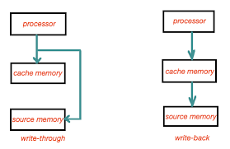
Write-Through vs Write-Back
Write-Through: Writes to both the cache-line and the next level of memory concurrently.
Allows the next level of cache to always be up to data.
However creates a lot of memory traffic.
Write-Back: The value is written only to the cache line. The modified cache line is written to next memory level only when evicted.
Reduces memory traffic, by buffering writes.
Memory value in the next level may be stale or not up to date.

Slide 58
Cache Coherency Policy

Slide 59
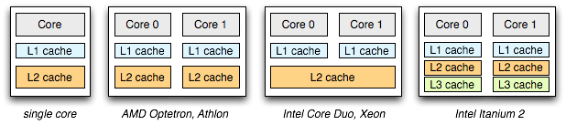
Multi-Core Caching
With multi-core processors, organizing caching hierarchies can be pretty interesting, since some cache may be private or shared between multiple cores. However since they all access the same memory, the data between the caches must be coherent, and be up-to date with new data.

Slide 60
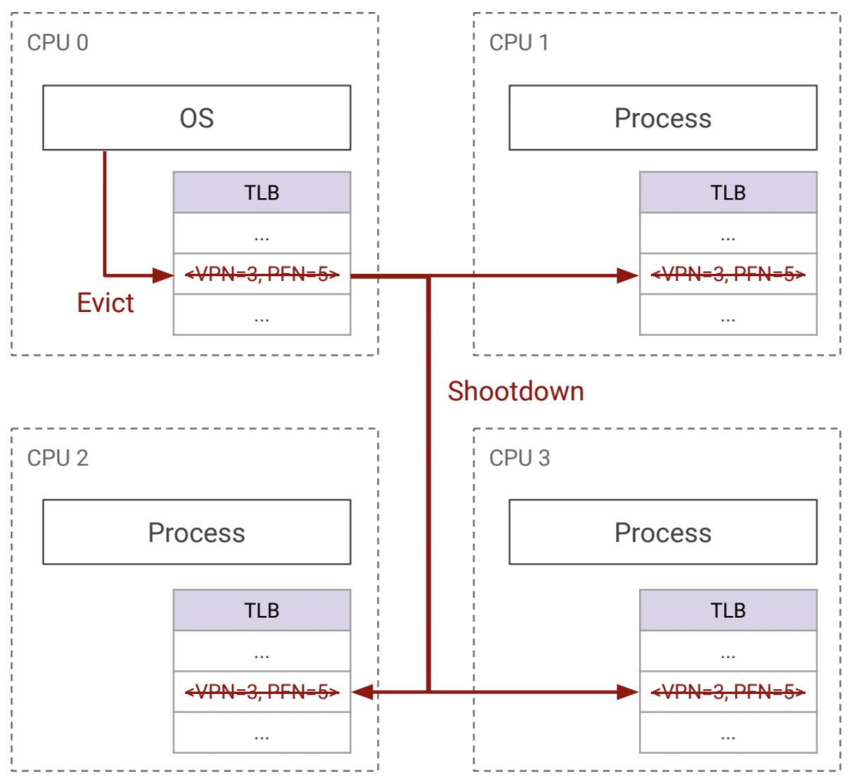
Coherence Protocols
Write-invalidate: an invalidate message is sent to all caches that are snooping on the bus, making their cache entries no longer valid. This requires processors to check each others caches for the valid cache entry.
Write-update: each cache will broadcast the data in the cache entry, and each processor will update locally.

Slide 61
Caching and Virtual Memory

Slide 62
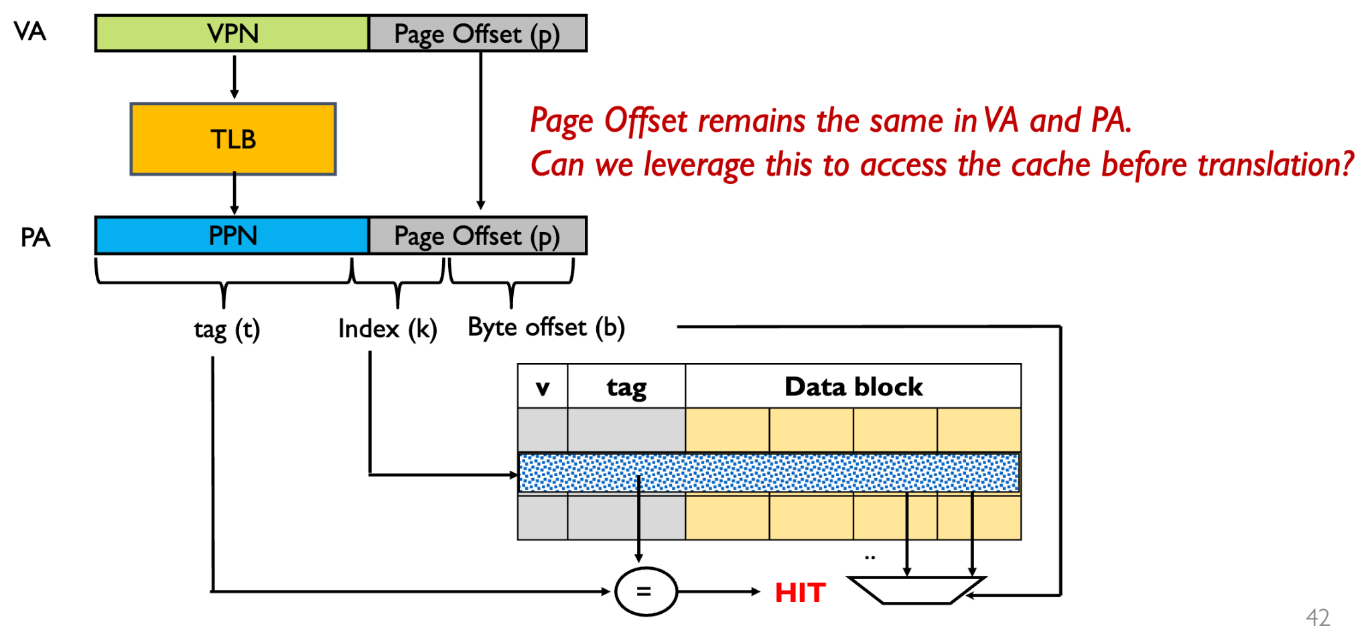
Physically Indexed - Physically Tagged (PIPT) Cache

Slide 63
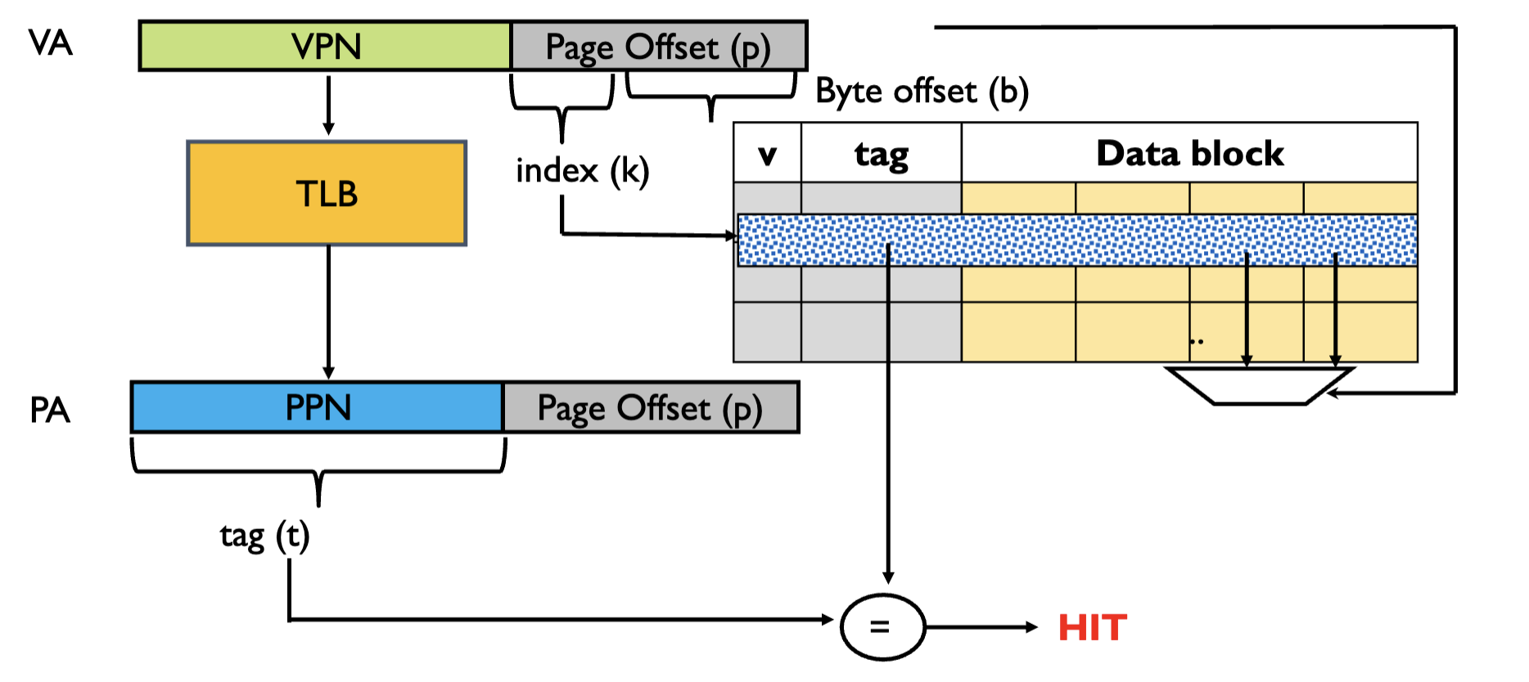
Virtually Indexed - Physically Tagged (VIPT) Cache

Slide 64
Project 3 Questions?

Slide 65
Thanks for Attending :)

